Slide 1
Algorithm and Programming
Topic 04 Program Control Selection & Repetition
Arief Agus Sukmandhani, S.Kom., MMSI

Slide 2
Outline
At the end of this session, students will be able to:
LO 2: Analyze a program using C language for problem-solving

Slide 3
Outline
Selection
Repetition
Break Vs. Continue
Go to and Label
Error Type

Slide 4
Selection Definition
In an algorithm implementation, an instruction or block of instructions may be executed (or not) with certain predetermined condition
Syntax:
if
if-else
switch-case

Slide 5
Selection: IF
Syntax :
if (boolean expression) statement;
or
if (boolean expression) {
statement1;
statement2;
……
}
If boolean expression resulting in True, then a statement or some statements will be executed.
Block of statements

Slide 6
Selection: IF
Flow Chart of IF Statement
false
true
condition
statements

Slide 7
Selection: IF-ELSE
Syntax :
if (boolean expression) statement1;
else statement2;
or
if (boolean expression){
statement1;
statement2;
……
}
else {
statement3;
statement4;
…
}
If boolean expression resulting in TRUE, then statement1 or block statement1 will be executed, if FALSE then statement2 or block statement2 be executed.
Block statement1
Block statement2

Slide 8
Selection: IF-ELSE
Flow Chart of IF-ELSE Statement
false
true
condition
statements 2
statements 1

Slide 9
Selection: NESTED-IF
Nested selection occurs when the word IF appears more than once within IF statement.
Syntax :
if (boolean expression) statement1;
if (boolean expression) statement2;
if (boolean expression) statement3;
or
if (boolean expression) statement1;
else
if (boolean expression) statement2;
else
if (boolean expression) statement3;

Slide 10
Program Examples Using IF
Example 1:
Program example to find the roots of a quadratic equation
Algorithm :
1. Get the value of coefficients a, b, and c from keyboard
2. Calculate discriminant d = b*b – 4*a*c
3. if d >= 0 then calculate x1 and x2
if d < 0 then stated imaginer, stop.
4. Stop
calculate x1 using :
calculate x2 using :
-b +√ d
2*a
-b -√ d
2*a

Slide 11
Program Examples Using IF
#include <stdio.h>
#include <math.h>
int main()
{
float a,b,c,d,x1,x2;
printf(“ Input coef. a : “); scanf(“%f”,&a);
printf(“ Input coef. b : “); scanf(“%f”,&b);
printf(” Input coef. c : ”); scanf(“%f”,&c);
d = b*b - 4 * a * c;
if (d >= 0){
x1 = (-b + sqrt(d)) / (2 * a);
x2 = (-b - sqrt(d)) / (2 * a);
printf(“x1=%f\n x2=%f\n”,x1,x2);
}
else printf(” Imaginer root equation”);
return 0;
}
sqrt() is a function used to calculate root from a number, and it is defined on <math.h> library

Slide 12
Program Examples Using IF
Standard Library Function : sqrt()
The previous slide shows program example using sqrt() function
Syntax :
double sqrt (double x);
Header file <math.h>
To find a square root for a value x, where x is non-negative
Example:
z = sqrt(45.35);
then value of z is 6.73

Slide 13
Program Examples Using IF-ELSE
Example 2: (Calculator Program)
#include<stdio.h>
int main()
{
float val1, val2;
char op;
while(1) {
printf(“\n Type val1 operator val2, (example: 3 * 4) \n”);
scanf(“%f %c %f”, &val1, &op, &val2);
if(op == ‘+’) printf(“ = %f”, val1 + val2);
else if(op == ‘-’) printf(“ = %f”, val1 - val2);
else if(op == ‘*’) printf(“ = %f”, val1 * val2);
else if(op== ‘/’) printf(“ = %f”, val1 / val2);
else{
printf(“ error: choose operator +,-,* and / \n”);
break;
}
}
return 0;
}

Slide 14
Program Examples Using IF-ELSE
Example 3: Wrong IF (unclear IF statement)
#include<stdio.h>
int main()
{
int degree:
printf(“Input degree: “);
scanf(“%d”, &degree);
if (degree < 80)
if (degree > 30)
printf (“Hot\n”);
else
printf (“Cool\n”);
}

Slide 15
Selection: SWITCH-CASE
Switch-Case Operation
This statement is used in exchange of IF-ELSE, when if-else nested number of level is enormous and difficult to read
Syntax:
switch (expression) {
case constant1 : statements1; break;
.
.
case constant2 : statements2; break;
default : statements;
}

Slide 16
Selection: SWITCH-CASE
Switch statement evaluate an expression by looking up for each case constant value. If an expression value matches with a case constant value then related statement/s is executed. If nothing match then default statement is executed.
Note:
Expression and constant type should be integer (including char)

Slide 17
Selection: SWITCH-CASE
Flow Chart of SWITCH-CASE Statement
true
case a
case a action(s)
break
false
case b
true
case b action(s)
break
false
.
.
.
case z
true
case z action(s)
break
false
default action(s)

Slide 18
Program Examples Using SWITCH-CASE
Example:
#include <stdio.h>
int main()
{
float val1, val2; char op;
while(1) {
printf(“\n Type val1 operator val2 \n”);
scanf(“%f %c %f”, &val1, &op, &val2);
switch(op){
case(‘+’): printf(“ = %f”, val1 + val2); break;
case(‘-’) : printf(“ = %f”, val1 - val2); break;
case(‘*’) : printf(“ = %f”, val1 * val2); break;
case(‘/’) : printf(“ = %f”, val1 / val2); break;
default : printf(“ unknown operator!”);
}
}
return(0);
}
Note: case (’+’) can also written case ’+’

Slide 19
?: Operator
The operator ?: is similar to the IF statement, but it returns a value
Syntax:
condition ? then-expression : else-expression
Using this operator, you can rewrite
if(a > b)
max_value = a;
else
max_value = b;
as
max_value = (a > b) ? a : b;

Slide 20
Program Examples
Program Example: (Exam Grading System)
Grading table
Algorithm and Programming subject comes with laboratory class; thus the final score calculation is:
Class score = 50%(final) + 30%(mid term) + 20%(assignment)
Lab. score = 40%(final) + 30%(mid term) + 30%(assignment)
Final score = 0.8* Class + 0.2* Lab
Score | Weight | Grade
85 - 100 | 4 | A : high distinction
75 – 84 | 3 | B : distinction
65 – 74 | 2 | C : pass
50 – 64 | 1 | D : conceded pass
0 - 49 | 0 | E : fail

Slide 21
Program Examples
/*-------------------------
Exam Grading Program
-------------------------*/
#include <stdio.h>
#include <stdlib.h>
#include <math.h>
int assignClass, assignLab;
int midClass, midLab, finalScore;
int finalClass, finalLab;
float scoreClass, scoreLab;
char answer;

Slide 22
Program Examples
int main()
{
system(“cls”);
printf(” Continue [Y/T] ? ”); scanf(“%c”,&answer);
while (toupper(answer) == ’Y’) {
printf(” Assign class (0 -100) : ”); scanf(“%d”,&assignClass);
printf(” Assign lab (0 -100) : ”); scanf(“%d”,&assignLab);
printf(” mid class (0 -100) : ”); scanf(”%d”,&midClass);
printf(“ mid lab (0 -100) : ”); scanf(”%d”,&midLab);
printf(“ fin class (0 -100) : “); scanf(“%d”,&finalClass);
printf(“ fin class (0 -100) : “); scanf(“%d”,&finalLab);
scoreClass = 0.2*assignClass+0.3*midClass + 0.5*finalClass;
scoreLab = 0.3*assignLab + 0.3*midLab + 0.4*finalLab;
finalScore = ceil(0.8*scoreClass + 0.2*scoreLab);
if(finalScore >=85) printf(“finalScore = A”);
else if(finalScore >=75) printf(“finalScore = B”);
else if(finalScore >=65) printf(“finalScore = C”);
else if(finalScore >=50) printf(“finalScore = D”);
else printf(“finalScore = E”);
printf(“\n”);
printf(“Continue[Y/T] ? “); scanf(“%c”,&answer);
}
}

Slide 23
Program Examples
Example on previous slide using:
system(“cls”)
clear screen
Header file: <stdlib.h>
toupper()
syntax: int toupper(int c);
converting char c to capital letter
Header file: <ctype.h> and <stdlib.h>

Slide 24
Repetition Definition
One or more instruction repeated for certain amount of time
Number of repetition can be predefined (hard-coded in program) or defined later at run time
Repetition/looping operation:
for
while
do-while

Slide 25
Repetition: FOR
Syntax:
for(exp1; exp2; exp3) statement;
or:
for(exp1; exp2; exp3){
statement1;
statement2;
…….
}
exp1 : initialization
exp2 : conditional
exp3 : increment or decrement
exp1, exp2 and exp3 are optional

Slide 26
Repetition: FOR
exp1 and exp3 can consist of several expression separated with comma
Example:
void reverse(char ss[])
{
int c,i,j;
for(i=0, j=strlen(ss)-1; i<j; i++, j--){
c=ss[i];
ss[i]=ss[j];
ss[j]=c;
}
}

Slide 27
Repetition: FOR
Flow Chart of FOR Statement
exp1
exp3
statements
true
exp2
false

Slide 28
Repetition: FOR
Example:
for (x=1; x <= 10; x++) printf(“%d\n”, x);
x=1
x <= 10
True
printf(”%d\n”,x)
x++
False

Slide 29
Repetition: FOR
Example:
Program to print out numbers from 1 to 10
Program to print out numbers from 10 to 1
#include<stdio.h>
int main()
{
int x;
for( x = 1 ; x <= 10 ; x++ ) printf( "%d\n", x );
return(0);
}
#include<stdio.h>
int main()
{
int x;
for( x = 10 ; x >= 1 ; x-- ) printf( "%d\n", x);
return(0);
}

Slide 30
Repetition: FOR
Example: (Calculating average of monthly expenses)
/*----------------------------------*/
/* Program Averaging */
/*----------------------------------*/
#include<stdio.h>
int main()
{
float data, total, average;
int x;
total = 0.0;
for( x = 1; x <= 4; x++) {
printf(“ Data week-%d :”,x);
scanf(“%f”,&data);
total = total + data;
}
average = total / 4;
printf(“Average = Rp %8.2f\n”,average);
return(0);
}

Slide 31
Repetition: FOR
Infinite Loop
Loop with no stop condition can use “for-loop” by removing all parameters (exp1, exp2, exp3). To end the loop use break.
Nested Loop
Loop in a loop. The repetition operation will start from the inner side loop.

Slide 32
Repetition: FOR
C
int x, y;
for (x=1;x<=5;x++)
for (y=5; y>=1; y--)
printf(”%d %d ”,x,y);
C++
NESTED LOOP
for (int x=1;x<=5;x++)
for (int y=5; y>=1; y--)
printf(”%d %d ”,x,y);
Output :
1 5 1 4 1 3 .. 2 5 2 4 .. 5 1

Slide 33
Repetition: FOR
Example: (Truth Table)
/*-----------------------------------
Program: the truth table;
------------------------------------*/
#include <stdio.h>
int main()
{
int P,Q;
printf(“==============================\n”);
printf(“P Q P or Q P and Q Not P P xor Q\n”);
printf(“==============================\n”);
for(P=1; P>=0; P--)
for(Q = 1; Q>=0; Q--)
printf(“%4d %4d %4d %4d %4d %4d\n”, P, Q, P||Q, P&&Q, !P, P^Q );
printf(“==============================\n”);
}

Slide 34
Repetition: WHILE
Syntax :
while (exp) statements;
or:
while(exp){
statement1;
statement2;
…..
}
Example :
int counter = 1;
while ( counter <= 10 ) {
printf( "%d\n", counter );
++counter;
}

Slide 35
Repetition: WHILE
Flow Chart of WHILE Statement
statements
condition
true
false

Slide 36
Repetition: WHILE
while (exp) statements;
exp is Boolean expression. It will result in true (not zero) or false (equal to zero).
Statement will be executed while the exp is not equal to zero.
exp evaluation is done before the statements executed.

Slide 37
Repetition: WHILE
Example :
while(product <= 1000) product = 2*product;
product <= 1000
True
product=2*product;
False

Slide 38
Repetition: WHILE
These code are analogous
#include<stdio.h>
void main() {
int x;
for( x = 1 ; x <= 10 ; x++ )
printf( "%d\n", x );
}
#include<stdio.h>
void main() {
int x = 1;
while (x<=10) {
printf( "%d\n", x );
x++;
}
}

Slide 39
Repetition: DO-WHILE
Syntax :
do{
< statements >;
} while(exp);
Keep executing while exp is true
exp evaluation done after executing the statement(s)
Example :
int counter=0;
do {
printf( "%d ", counter );
++counter;
} while (counter <= 10);

Slide 40
Repetition: DO-WHILE
Flow Chart of DO-WHILE Statement
statements
true
condition
false

Slide 41
Repetition: DO-WHILE
Example:
do{
printf(”%d\n”,counter);
} while(++counter <=10);
printf(”%d\n”,counter);
++counter <=10
True
False

Slide 42
Repetition Operation
In while operation, statement block of statements may never be executed at all if exp value is false
In do-while on the other hand statement block of statements will be executed min once
To end the repetition, can be done through several ways:
Sentinel
Question, should the repetition continue?

Slide 43
Repetition Operation
Example: (Sentinel)
As sentinel, used 0 for width or height
#include <stdio.h>
int main()
{
int width, height, area;
do{
printf(” Width : ”);
scanf(”%d”,&width);
printf(” Height : ”);
scanf(”%d”,&height);
area = width*height;
printf(” Area = %d\n\n”,area);
} while((width != 0) && (height != 0));
return(0);
}

Slide 44
Break vs Continue
Example using continue:
#include <stdio.h>
int main() {
int x;
for(x=1; x<=10; x++) {
if (x == 5) continue;
printf("%d ", x);
}
return 0;
}
Output : 1 2 3 4 6 7 8 9 10

Slide 45
Break vs Continue
Example using break:
#include <stdio.h>
int main() {
int x;
for(x=1; x<=10; x++) {
if (x == 5) break;
printf("%d ", x);
}
return 0;
}
Output : 1 2 3 4

Slide 46
Go To and Label
C is still providing the old fashion goto statement
Syntax:
goto label;
……
label :
……
label is written using colon symbol
Avoid using goto to improve code readability

Slide 47
Error Type
Compile-Time Error
caused by syntax error
Link-Time Error
success fully compiled, but cause link error
caused by no object code at link time
Run-Time Error
successfully compiled, but error at runtime. Usually caused by numerical operation such as: overflow, floating point underflow, division by zero, etc.
Logical Error
wrong result caused by incorrect logical flow/algorithm

Slide 48
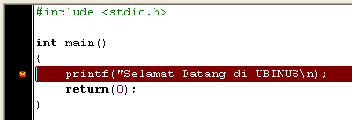
Error Type
Among those Error Types the most difficult to debug is Logical Error.
Example of Compile-Time Error:
Dev-C compiler will give message: In function main missing terminating ” character, syntax error before return

Slide 49
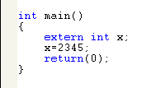

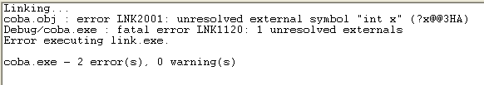
Error Type
Some C compiler merge the compile and link processes, causing in difficulty to distinguish between Compile-Time Error with Link-Time Error
Example of Link-Time Error (Visual C++)

Slide 50
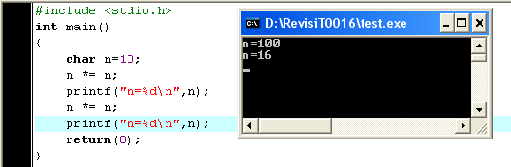
Error Type
Example for Run-Time Error
successfully compiled and linked, but RUN result, causing by overflow (char range max 127)

Slide 51
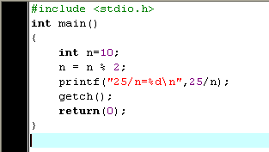
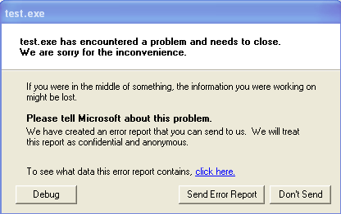
Error Type
Example for Run-Time Error
Error cause:
Division by Zero

Slide 52
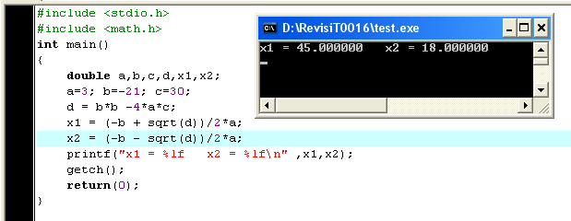
Error Type
Example for Logical-Error
Should be: x1 = 5.00 and x2 = 2.00
Can you find the logic error ??

Slide 53
Error Type
Example for Logical-Error
Should be: x1 = 5.00 and x2 = 2.00
Can you find the logic error ??

Slide 54
Example Labeling
Example using labeling:
#include <stdio.h>
int main() {
int x;
for(x=1; x<=10; x++) {
if (x == 5) goto exit;
printf("%d ", x);
}
exit:
return 0;
}
Output : 1 2 3 4

Slide 55
Summary
In an algorithm implementation, an instruction or block of instructions may be executed (or not) with certain predetermined condition, that’s why we use selection
3 types of selection in C:
if
if-else
switch-case
Repetition is a condition which is one or more instruction repeated for certain amount of time
3 types of repetition/looping in C:
for
while
do-while

Slide 56
References
Paul Deitel & Harvey Deitel. (2016). C how to program : with an introduction to C++. 08. Pearson Education. Hoboken. ISBN: 9780133976892. Chapter 3 & 4
Choosing between Alternatives: http://docs.roxen.com/pike/7.0/tutorial/statements/conditions.xml
Getting Controls: http://aelinik.free.fr/c/ch10.htm
Doing the Same Thing Over and Over: http://aelinik.free.fr/c/ch07.htm
https://www.tutorialspoint.com/cprogramming/c_goto_statement.htm

Slide 57
THANK YOU

